Slide 1
Chapter 16
Introduction to Ajax
Programming the World Wide Web
Fourth edition
By Robert W. Sebesta

Slide 2
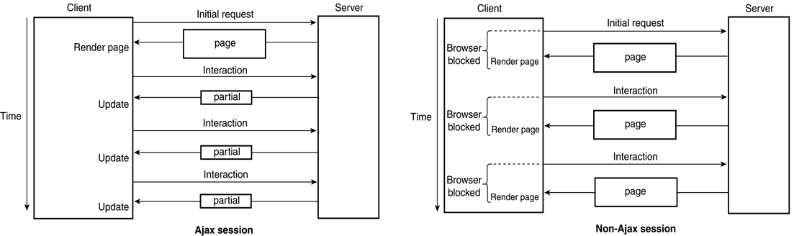
Figure 16.1 Traditional and Ajax browser/server interactions

Slide 3
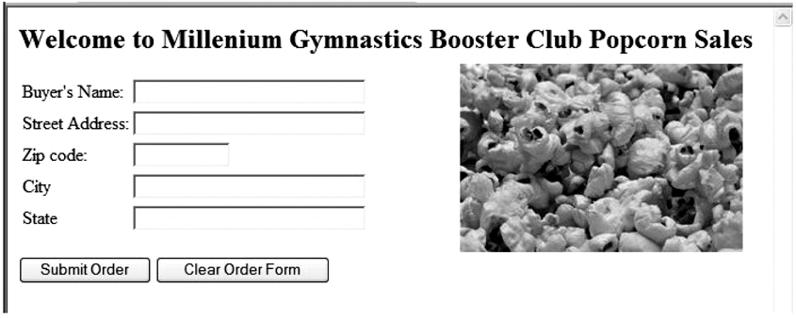
Figure 16.2 A display of the popcornA.html document

Slide 4
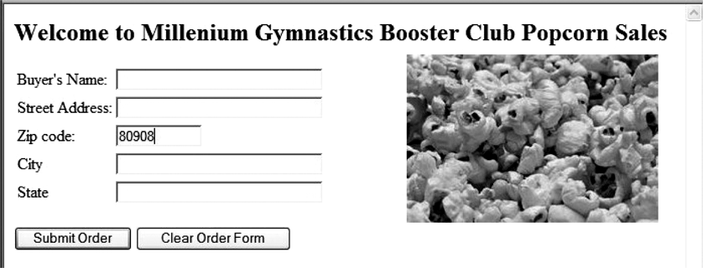
Figure 16.3 Display of the form after the zip code has been entered

Slide 5
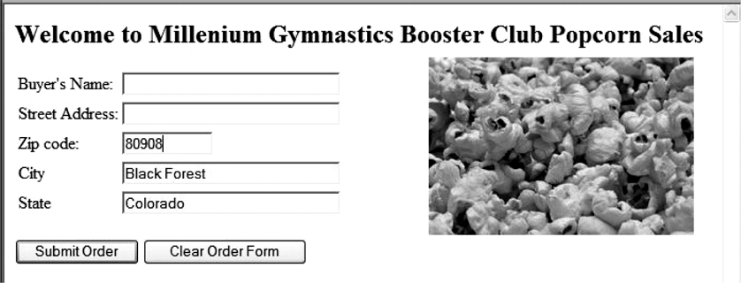
Figure 16.4 Display showing the city and state provided implicitly

